Slide 1
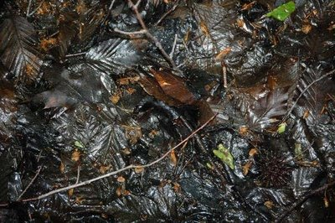
Decomposers in the stream

Slide 2
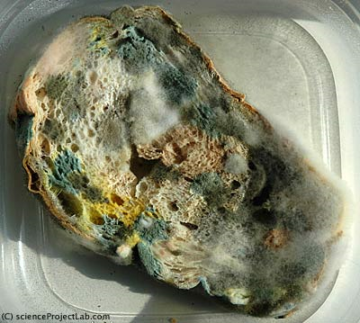
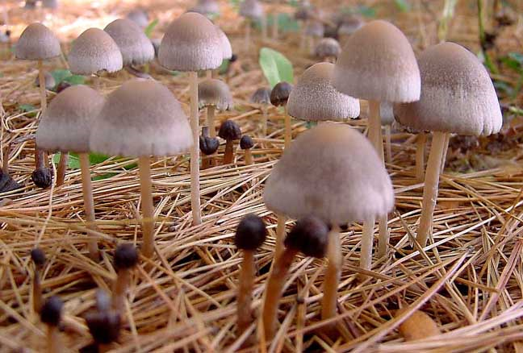
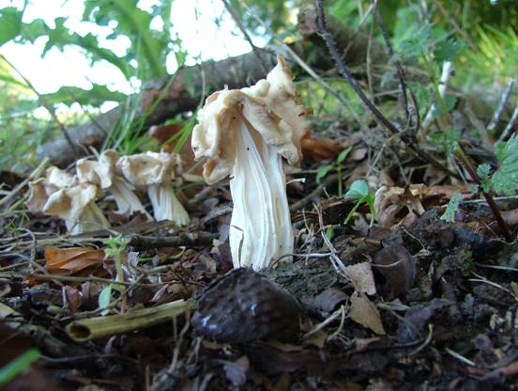
When we think of fungi, we usually think of mold on our food or mushrooms.
Notes:
What do these organisms look like? Describe them.
Mushrooms are tall and white/brown
Mold is fuzzy and white, yellow or green
What do you think these organisms are eating in these pictures?
Are they bigger or smaller than their food?
Most fungi are not mushrooms and not all fungi make mushrooms. We just like to think about these things because we can see them.

Slide 3
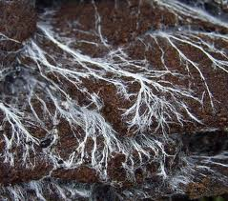
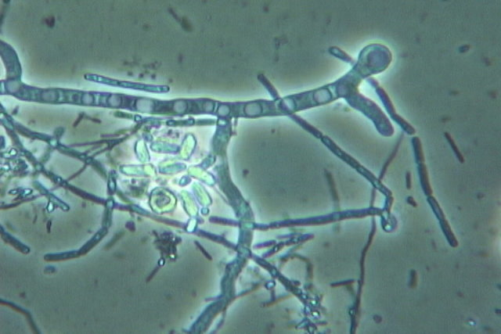
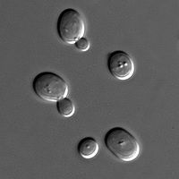
Fuzzy mold is made of millions of single strands of fungi. We can only see them when they grow in clumps—most fungi is too small to see without a microscope.
Fungi growing in soil (naked eye)
Fungi in compost (microscope)
Yeast are fungi too!
Fungi are found all over and are very important for decomposing plant material like leaves on land and in water.
Notes:
Single strands of fungi are called hyphae.

Slide 4
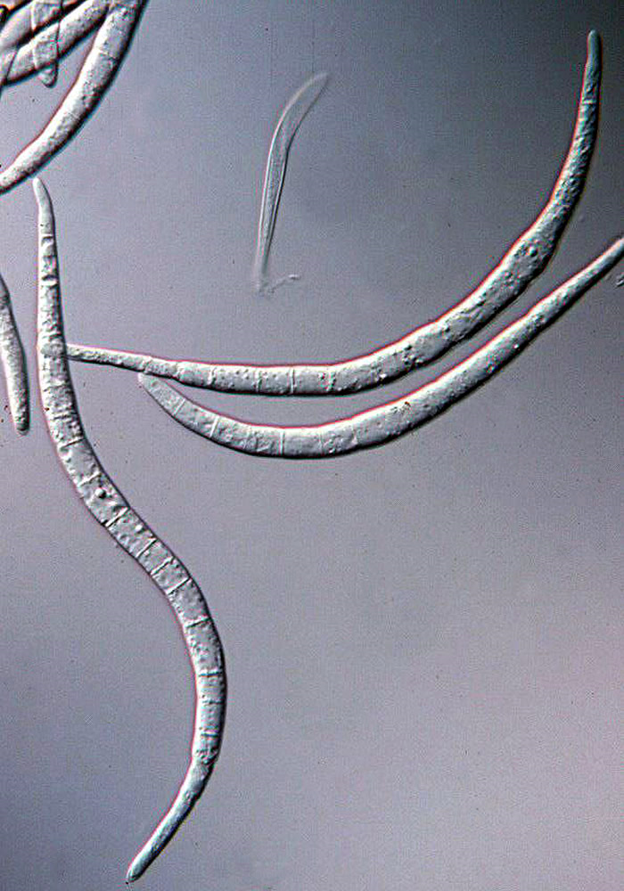
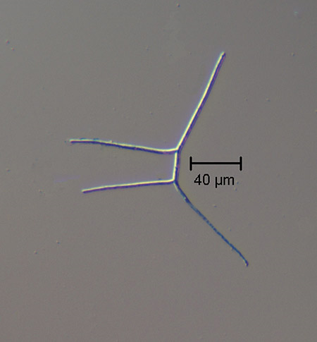
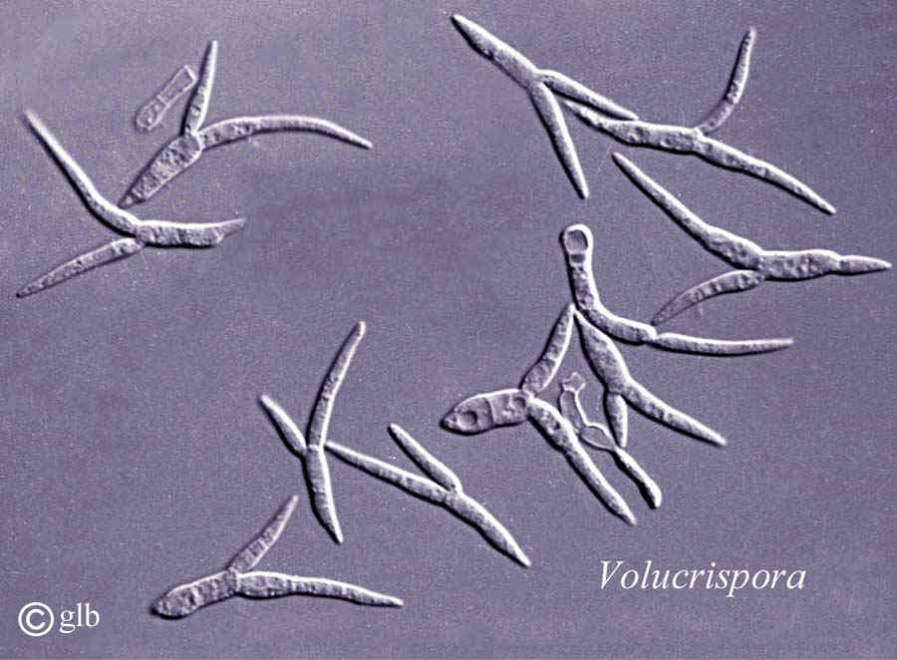
Here are 3 kinds of related fungi that live in streams and decompose dead organisms
Notes:
Aquatic Hyphomycetes http://www.microbelibrary.org/edzine/Details.asp?id=1572
http://fungi.life.illinois.edu/about/mitosporic_fungi
How would you describe these organisms?
Where do they fit on the Scales poster? – How big are they?

Slide 5
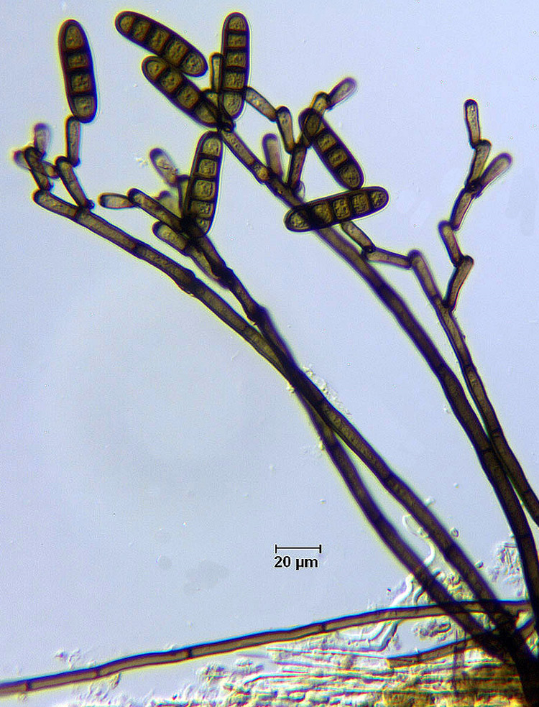
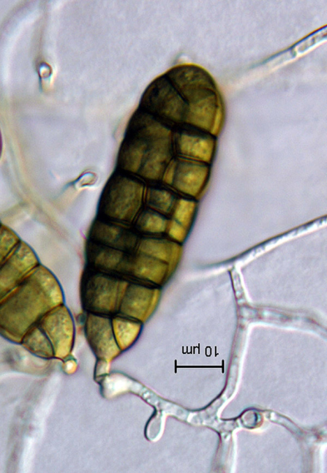
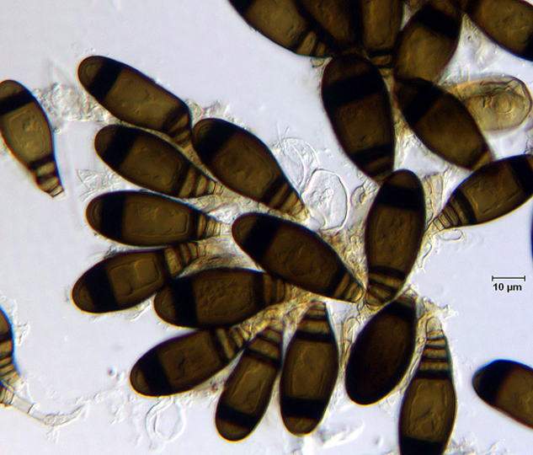
Here are 3 kinds of related fungi from a different group that also live in streams and decompose dead organisms
Notes:
More aquatic fungi Dematiaceous and Hyaline Mitosporic Fungi http://fungi.life.illinois.edu/about/mitosporic_fungi
How do these fungi look different than the others? Can you think of a reason why that might be?

Slide 6
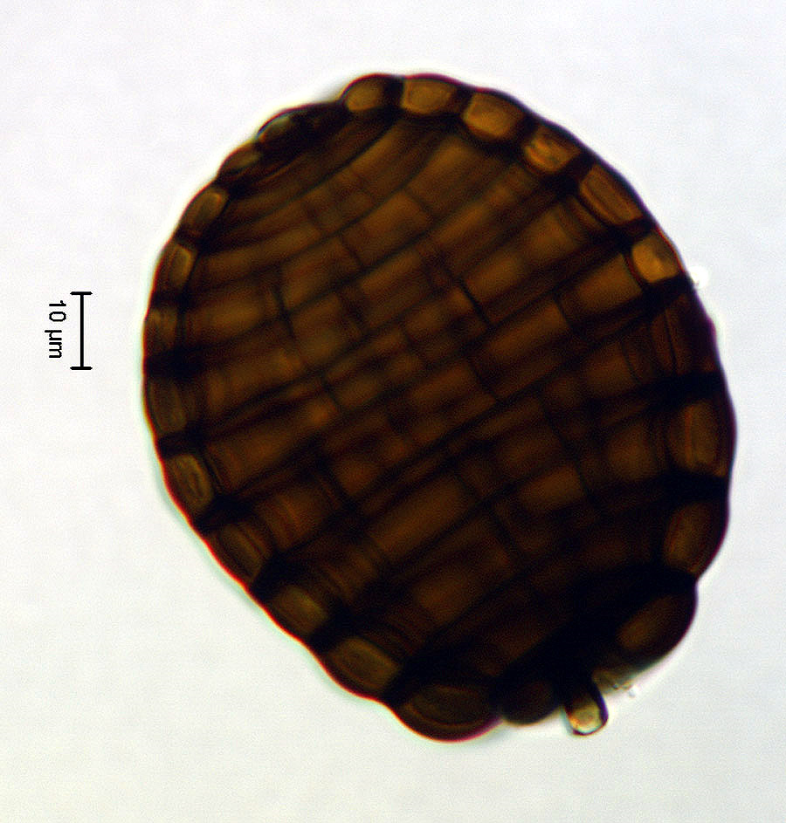
Here is another kind of fungi from a different group that also lives in streams and decomposes dead organisms. This type of fungi lives in places with less dissolved oxygen.
Notes:
Aeroaquatic Hyphomycetes

Slide 7
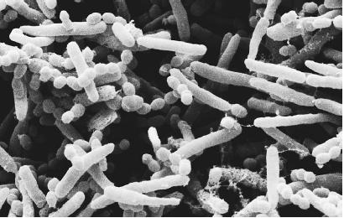
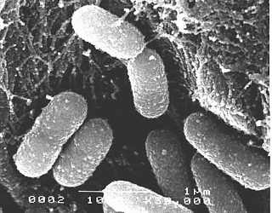
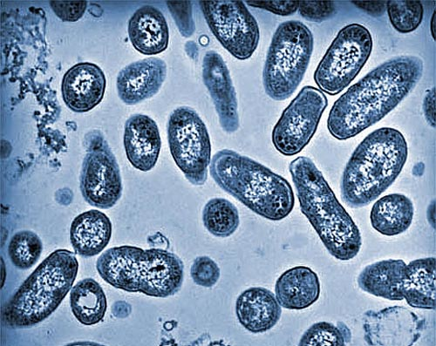
Bacteria are so small you need a very powerful microscope called an electron microscope to see them in this detail.
While many different groups of bacteria look very similar on the outside, they are very different on the inside.

Slide 8
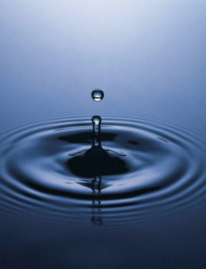
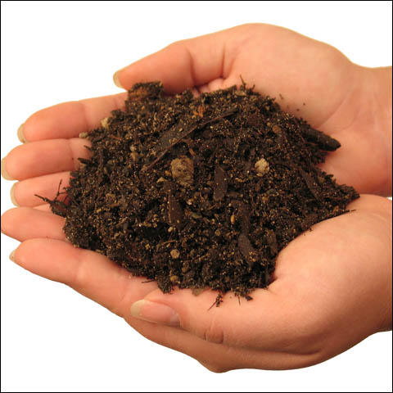
There are more bacteria and fungi on the planet than any other living thing. For example…
1 mL of fresh water can contain 1 million bacteria
1 g of soil can contain 1 billion bacteria
How many bacteria do you think could be in your leaf packs?
Notes:
Think about how many that really is and how many could possibly be in your leaf packs

Slide 9
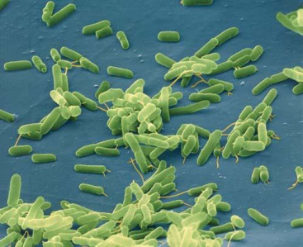
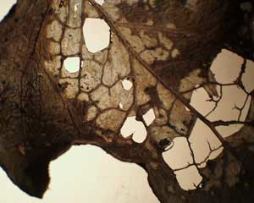
What happens when leaves fall from a plant?
Some get eaten (by microbes)
Some pieces stay in the water
Notes:
When a leaf falls from the tree and lands on the soil or in water, there are two possible pathways – leaching of nutrients and consumption by decomposers. All organic material will experience some leaching, although it depends on the conditions – the leaf may experience anywhere between 5-50% of its mass lost as leaching. For students, it might make sense to think about tea leaves, which impart a color to the water as they soak. That is “leaching”.

Slide 10
Think about how you eat…how is eating different for bacteria and fungi?
Bacteria
Food
Big difference between people and microorganisms: our food is smaller than us!
Notes:
People eat food and it is broken down in our digestive systems by enzymes. We get energy from the carbon bonds in our food and we breathe out CO2 and pee out nitrogen. This is decomposition too. But some of what we eat, we can’t break down and we poop out. That is not decomposition. The material has been changed but it has not been decomposed. This is a bit like shredders (like worms).
A big difference between people and microorganisms is that our food is a lot smaller than we are so we can take it into our bodies. Bacteria and fungi are so much smaller than the food they eat (e.g. shredded leaf material) that they have to digest their food outside their bodies. They release enzymes (like the ones in your stomach) out into the environment. The enzymes break the organic material (i.e. leaves) down into molecules that are smaller than the microorganisms. The bacteria and fungi can then “eat” those molecules by taking them inside their cell bodies through pores.
Decomposing leaf picture from SoilHealth.com
http://www.soilhealth.com/biology/organic.htm

Slide 11
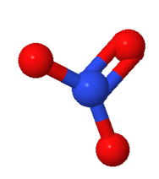
As microbes eat…a lot of minerals are left behind, since the microbes are “messy eaters”

Slide 12
What happens to the leaves when microbes eat?
Using the food for energy (respiration)
CO₂
Building new cells (mass)
Eating
Waste creation
Minerals “released”
Notes:
When bacteria “eat” the leaves, there are three pathways for what can happen to that material (carbon). They can use it to build mass, the carbon can be exhaled through respiration, or the carbon can be excreted as waste. Minerals are released as the microbes eat.

Slide 13
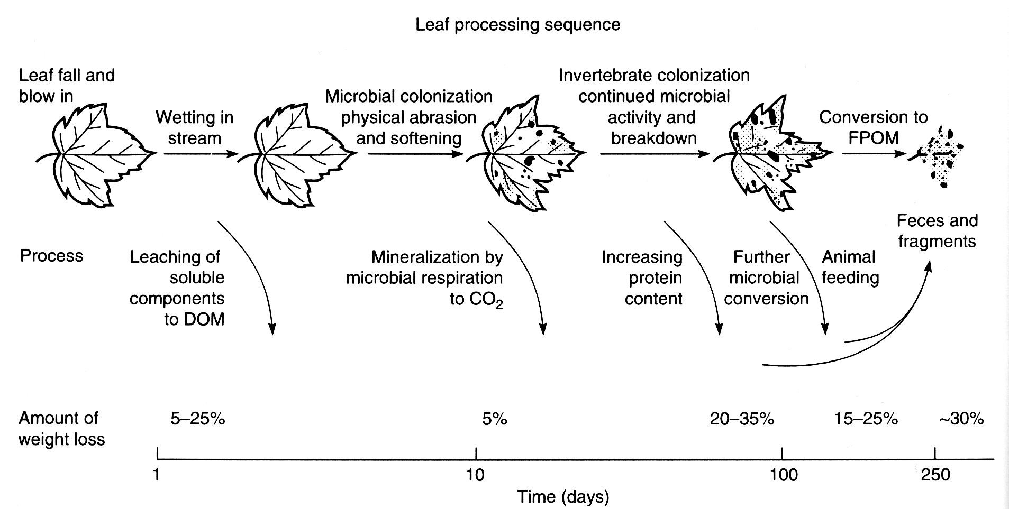
Notes:
FYI

